Slide 1
Charitable Giving

Slide 2
ADRA
They have a list of ways to raise money with virtual events e.g. virtual race or movie night.
Can donate as one off donations
Donate Monthly
Donate Quarterly
Donate yearly
Leave a Legacy: A Gift in your will
https://adra.org.uk/get-involved/fundraising/
https://adra.org.uk/donate/leave-a-legacy/

Slide 3
Next Door Neighbour App
Can be used to:
Get local news
Receive emergency alerts
Support local business
Receive updates from public services
Crime safety alerts, events, disaster plans, voicing concerns
https://nextdoor.co.uk/#neighbors

Slide 4
OLIO
It is free sharing app to give food and other household items away.
It’s aim is to avoid wasting items like food so people do not have to throw away left over food; or giveaway items that you do not have space to store.
Can choose a pick up location whether home, safe space, or any chosen public location.
https://olioex.com/
Notes:
This can be any item that is edible within the best before date. It can be unopened, cooked, raw, loose items and open.
During COVID only essential non-food items can be given away. Medicine that is over the counter within use-by-date, pet food, kitchen appliances, used perfume and makeup within use by date.

Slide 5
Be My Eyes
This is an app called Be My Eyes- See the world together.
This can aid those who are blind or partially sighted to get live assistance from sighted volunteers.
Through this app you can help to read small print; reading digital screens; colour coordinate clothes; help to set-up home appliances; trouble shoot technology; sorting music.
https://www.bemyeyes.com/

Slide 6
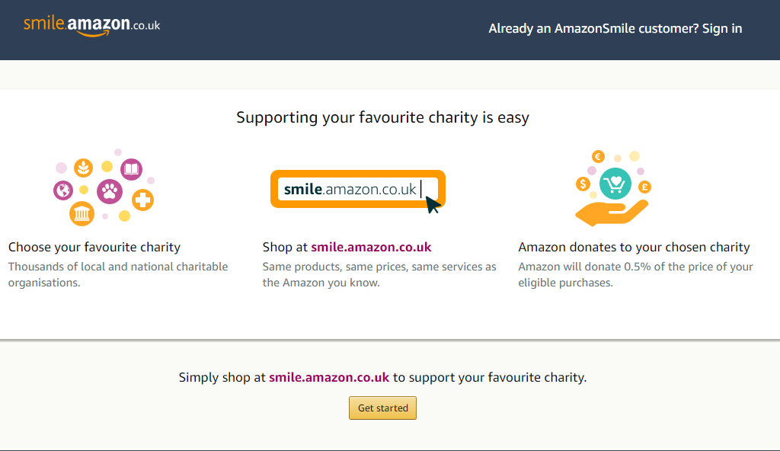
Amazon Smile
Same products on sale on smile.amazon.co.uk.
ADRA is also one of the charities on the list

Slide 7
Charitable Shopping
Works by making a free account and selecting the charity which can be changed at any time.
Shop through www.charitable.shopping for any of the stores online.
Shopping will be followed up and once the shop has verified the purchase they will pay the thank you fee which is transferred to the charity.

Slide 8
The Giving Machine
Make an account through the website or app.
Choose a maximum of 4 charities to support.
Shop at any of the retailers through your account.
The sales commissions that shops pay other sites is turned into donations.
https://www.thegivingmachine.co.uk/

Slide 9
Co-op
As a Co-operative member you can choose a local community cause.
Whenever you buy a Co-op product, 2p for every £1 spent is returned back to you the member.
The same amount will also go to the local community cause.
https://www.coop.co.uk/communities

